Slide 1


Slide 2
Concent
Part One
Part Two
Motivation & Background
Trends in the Data
Part Three
Part Four
For Movie Producers
For Streaming Companies
Notes:
Four parts: First, Second, Third, Fourth

Slide 3
01
Part One
Motivation and Background

Slide 4




01
Motivation and BG
$40 billion turnover in 2016
500,000 Movies During the History
Important Features In the Movie Industry
Notes:
Movie industry is growing more and more. For example, worldwide market had a box office of US$40 billion in 2016.
There were 500,000 movies during the history./
It is valuable to find which features relate to the performance of the movies.

Slide 5

01
Data Set
IMDB API http://www.omdbapi.com/
30 Attributes for 40,000 Movie Titles like Years of Release, Runtime Duration, Budget, Gross, Rating from IMDB and Tomato, etc

Slide 6
02
Part Two
Trends in the Data
Notes:
Second part => Trends in the data in the movie industry history

Slide 7
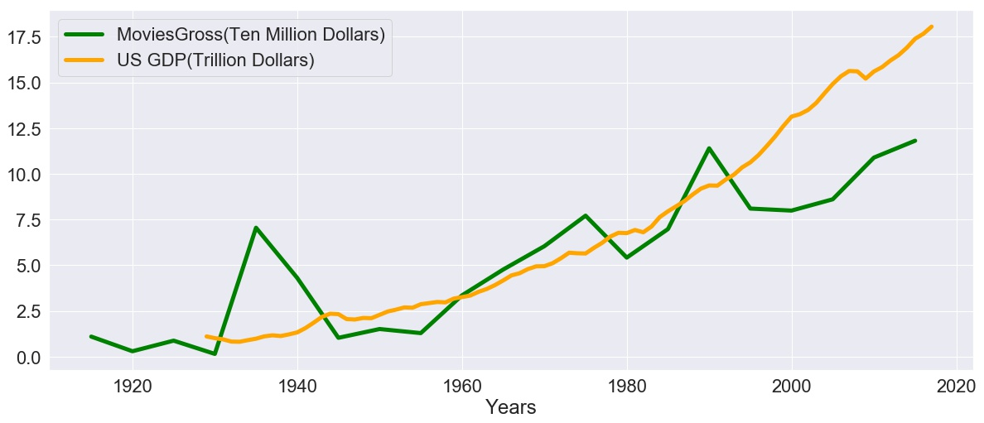
02
Trends in the Data
Movies gross
Relation with
Economy
Notes:
-
- Rise in the Movie Industry Gross
- A peak in the movie industry in 1930s and 1990s => it is a good time for movie industry because US economy in these decades was not good and people were more willing to pay for movies.

Slide 8
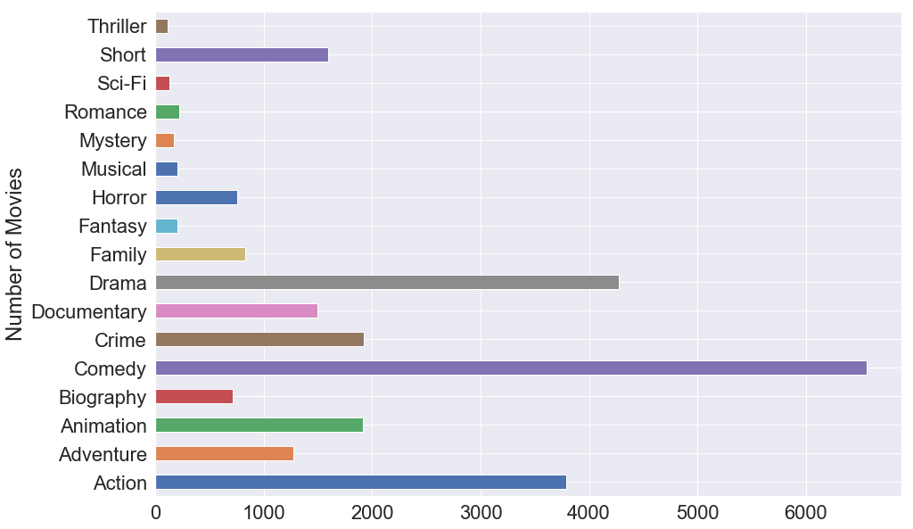
02
Trends in the Data
Old Genres
New Genres
Notes:
Number of movies in each genre in the history of movie industry
Comedy, Drama and Action are more than the others

Slide 9
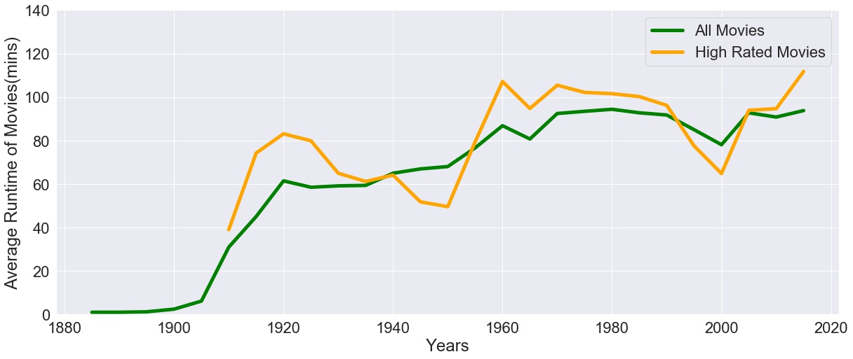
02
Trends in the Data
Runtime
increases
Notes:
Green curve => average runtime for all of the movies, Orange curve => average runtime for highly rated movies
General increase in average runtime during the history of movie making and again you can seen that the average runtime of all movies is around the average runtime of highly rated movies.

Slide 10
03
Part Three
For Movie Producers
Notes:
Delve into some interesting features for movie producers like 20th century fox, and Columbia that affects their Gross, Budget, and awards

Slide 11
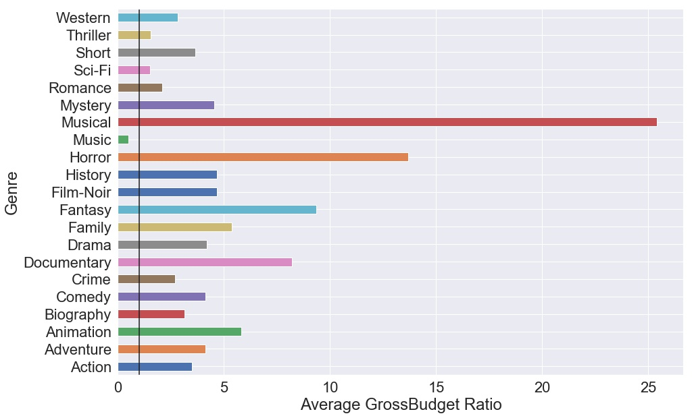
03
For Movie Producers
Most Profitable
Genres
Least Profitable
Genres
1
Notes:
- Shows average of Gross/Budget for all genres
- Most Profitable Genres => Musical, Horror, Fantasy
- Least Profitable Genres => Music Videos, Thriller, Sci-Fi
- Strict Line is one!

Slide 12
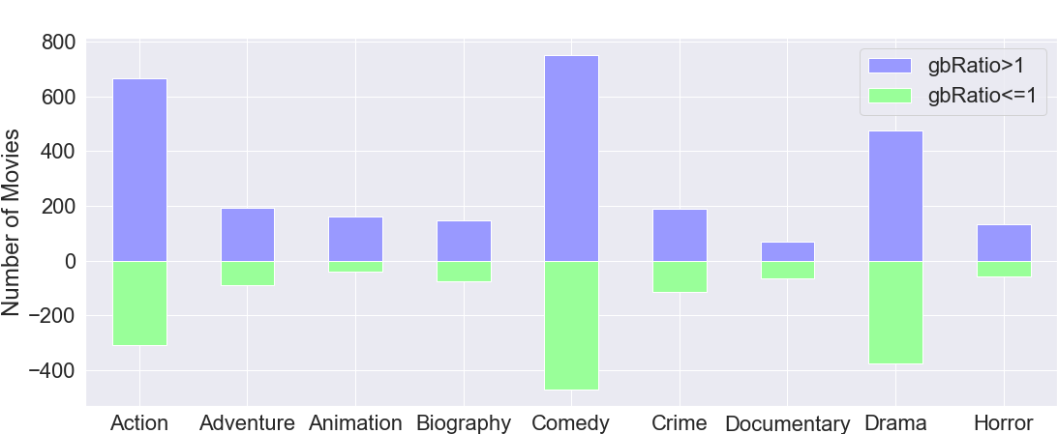
03
For Movie Producers
Notes:
We are looking at the number movies that are profitable and number of movies that are loss making in different genres
Although in the last figure mean of Gross/Budget ratio was high for Comedy, it may be also loss making => High Risk in Comedy Genre, More Profit in Popular Comedy Movies compared to popular movies in other genres

Slide 13
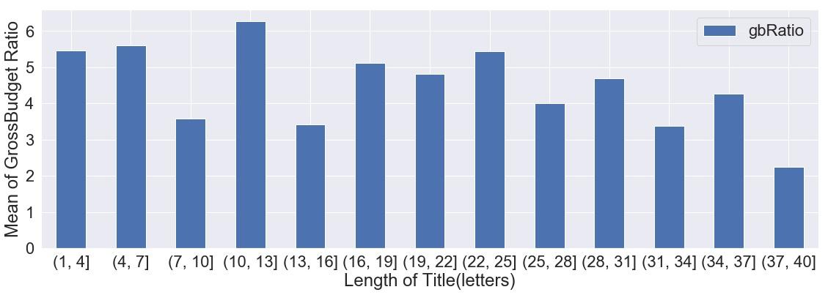
03
For Movie Producers
Not too much correlation
Don’t be too long
Notes:
Investigated the effect of length of title versus the mean of gross/budget ratio
Not too much correlation between gb ratio and length of title BUT Decrease in gb ratio when length of title is too long

Slide 14
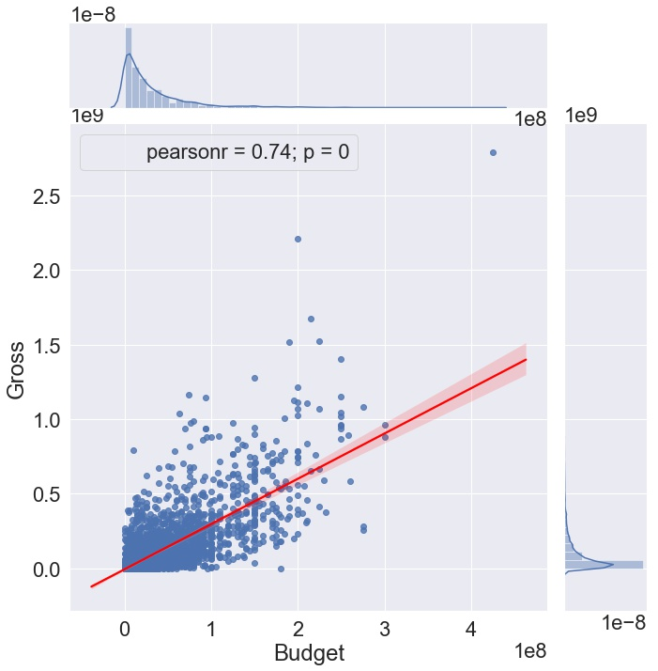
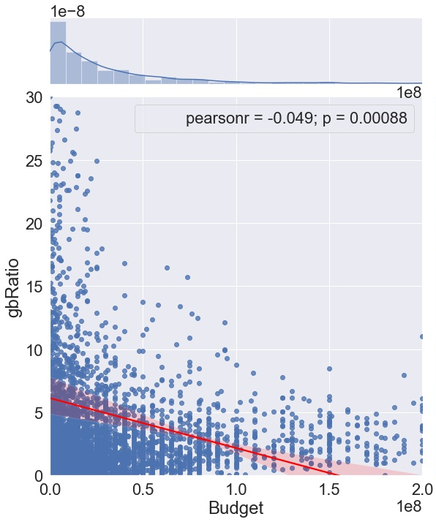
03
For Movie Producers
High Correlation
No Correlation
Notes:
Figure on the left => Correlation between Gross and Budget
Profit Definition: Gross => High Correlation Between Budget and Profit because correlation coefficient is close to one!
Figure on the right => Correlation between Gross and gb ratio
Profit Definition: Gross/Budget => No Correlation Between Budget and Profit because correlation coefficient is near zero!

Slide 15
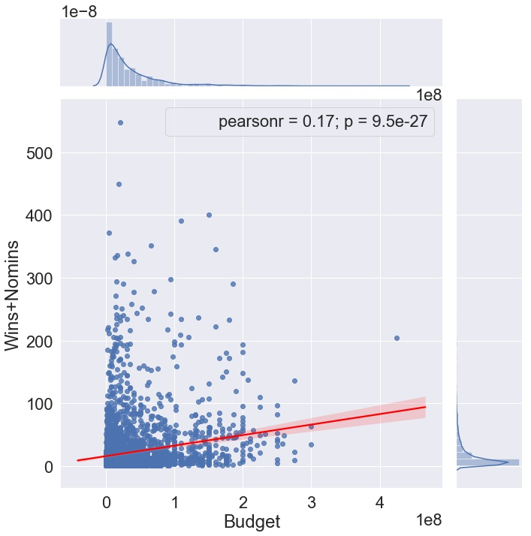
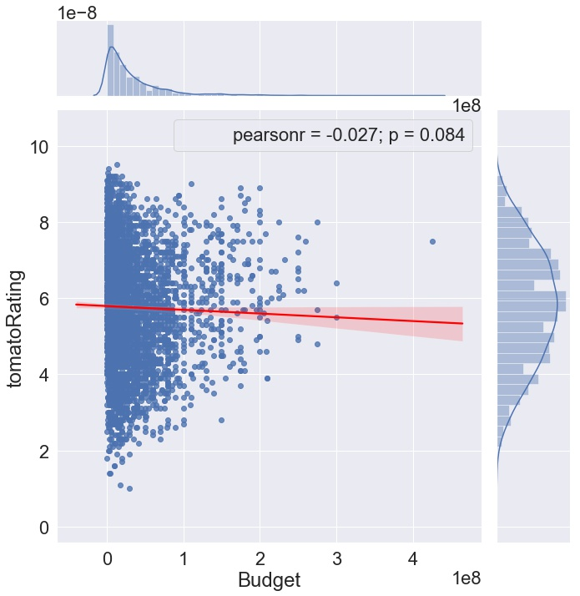
03
For Movie Producers
Low Correlation
No Correlation
Notes:
Figure on the left => Correlation between Number of wins and nominations and Budget
Very low Correlation Between Wins/Nomins and Budget
Figure on the right=> Correlation between tomato rating and Budget
Not too much correlation Between Tomato Rating and Budget

Slide 16
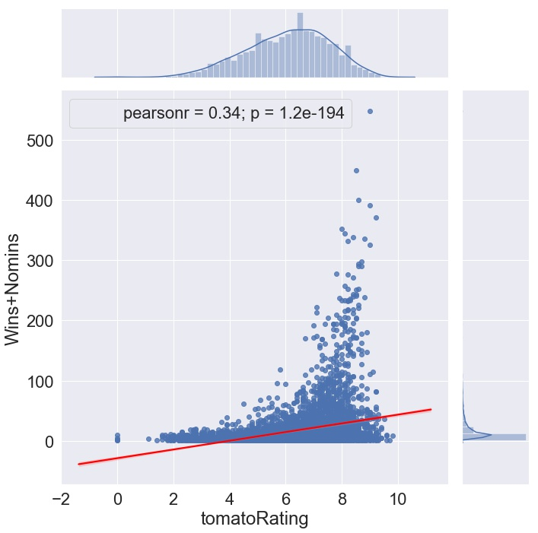
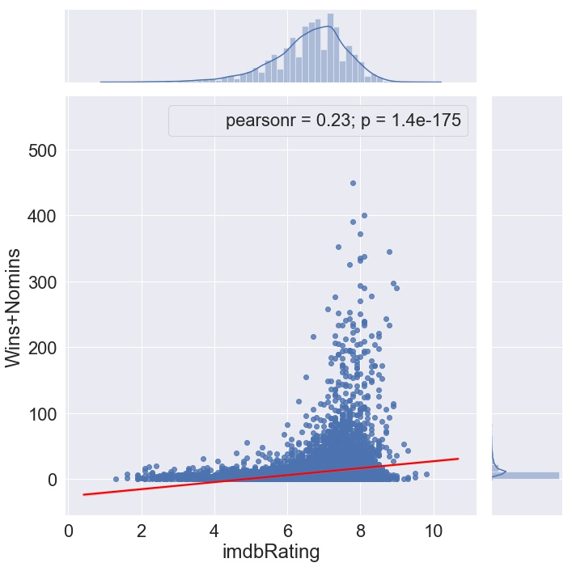
03
For Movie Producers
For Critics
For Audience
Notes:
- Wins/Nomins and imdbRating Correlation < Wins/Nomins and
Tomato Rating Correlation => Tomato Rating: Critics & Imdb Rating: Ordinary viewers

Slide 17
04
Part Four
For Streaming Company
Notes:
Delve into some interesting features for streaming companies like HBO, and Netflix that affects their Gross

Slide 18
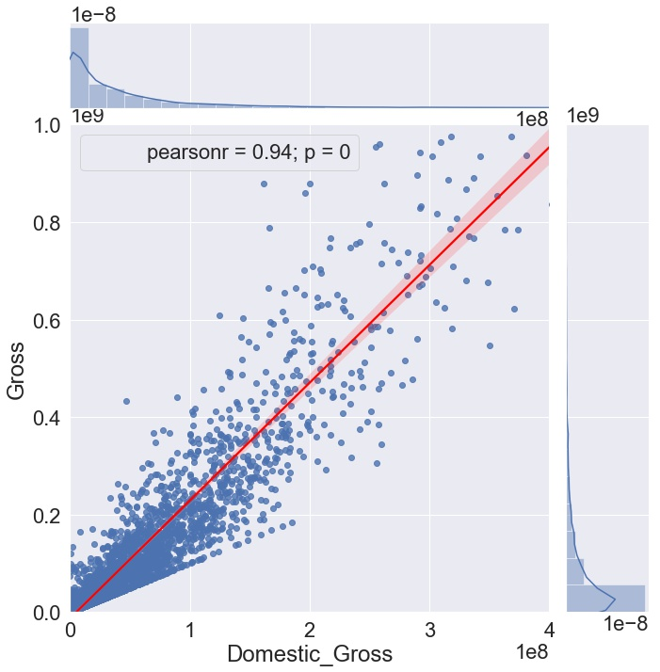
04
For Streaming Companies
High Correlation
US Movies are the most popular
Most movies are made in US
Notes:
High Correlation Between Domestic Gross and Gross all Over the World
Most of the Movies : US => If Americans like a movie and pay for it then most of the people will like it and pay for it with high probability

Slide 19
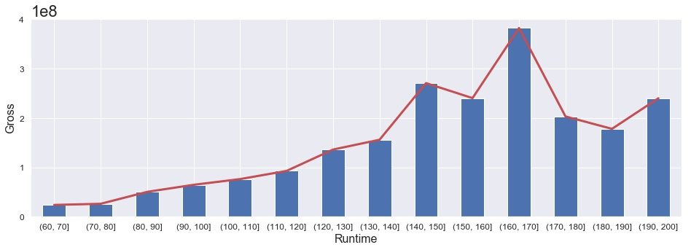
04
For Streaming Companies
Optimum Length of the Movie for More Profit (140,170) mins
Notes:
Optimum Length of the Movie for More Profit => (140,170) minutes

Slide 20
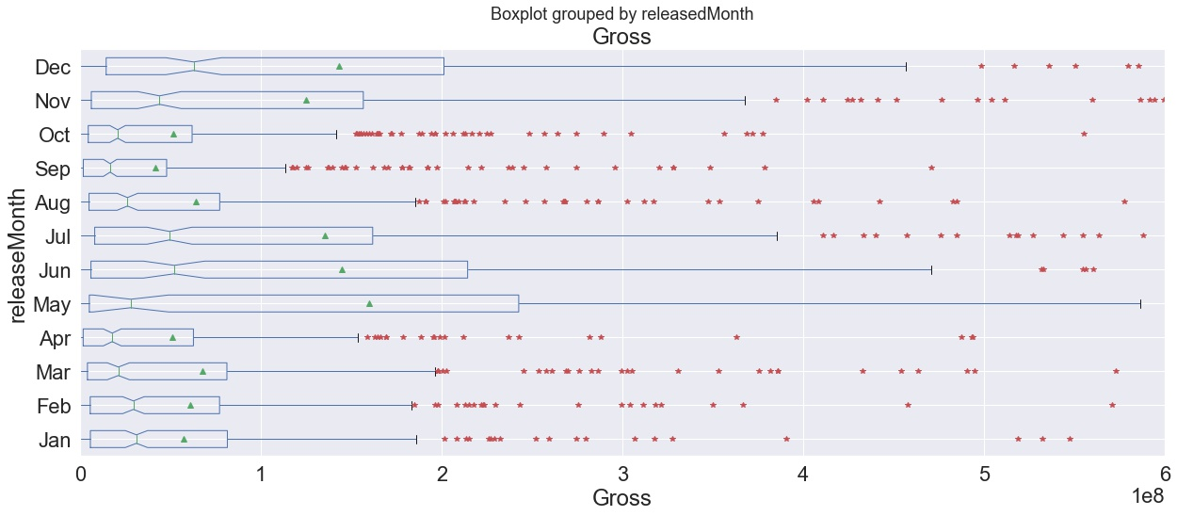
04
For Streaming Companies
May, June, July, December
May, June, July
Notes:
Release May, June, July, December => More Probable to Have a very high Gross => If a streaming company consider a movie as a profitable movies it is better to release it in May, June, July and December
Do not release in September, October and April

Slide 21
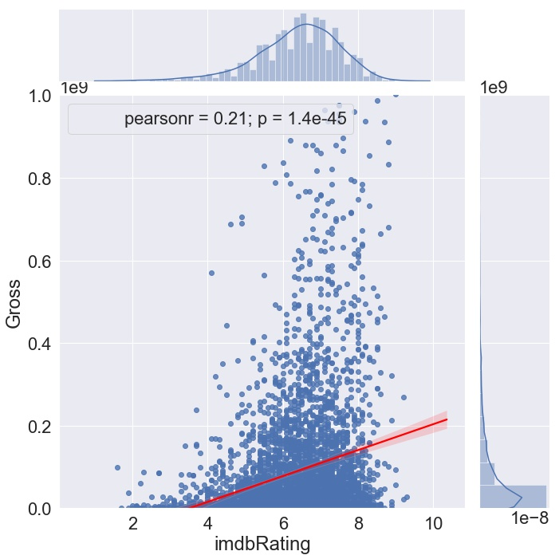
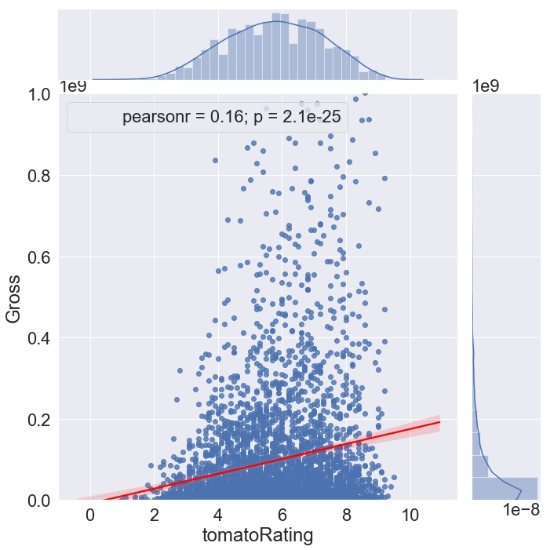
04
For Streaming Companies
For Audience
For Critics
Notes:
Gross and imdbRating Correlation > Gross and Tomato Rating Correlation => Tomato Rating: Critics & Imdb Rating: Audience

Slide 22


END
Conclusion
Useful Recommendations for Movie Producers:
Some Certain Genres for Making Profit
Movie Title Not Too Long
Gross => imdb rating, Wins and Nominations => Tomato Rating
Useful Recommendations for Streaming Companies:
High Gross in US => High Gross all over the world
Optimum Runtime for more profit: (140, 170) minutes
Release Movie in May, June, July, December

Slide 23


Slide 24
Q&A

